Slide 1
Choice Works
Question 5 – 10 marks (only one choice work or choice song will be asked)
You need to know the category, name and 2x features about each
There are 6 in total

Slide 2
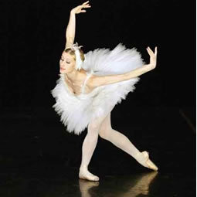
Choice Work 1
Category: Dance Movements
Name of work: Dance of the Swan from Swan Lake
Composer: P. Tchaikovsky
Features:
Minor key
4/4
Ternary form : ABA
Staccato is used frequently
Mostly woodwind & stringed instruments used

Slide 3
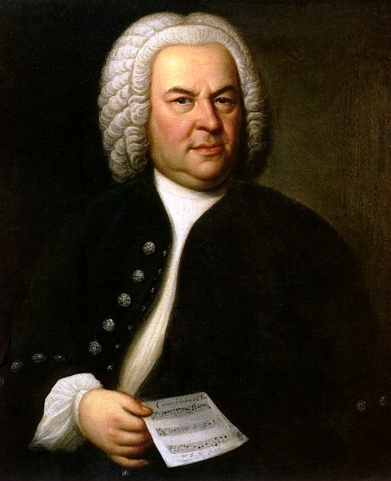
Choice Work 2:
Category: Movements from a classical symphony, symphonic suite or any orchestral work which uses Irish traditional or popular elements
Name of work: Badinerie from Orchestral Suite No. 2
Composer: J.S. Bach
Features:
B minor
Form AABB
Solo flute accompanied by strings & harpsichord = Main tune
Sequences in melody
Ornaments e.g. trills and turns

Slide 4
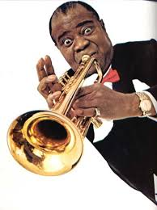
Choice Work 3
Category: Theme and variations in the classical or Irish repertoires or a jazz movement
Name of work: When the Saints Go Marching In
Composer: Louis Armstrong
Features:
Major key & Fast Tempo
Syncopated rhythm
Solo instruments: saxophone, trumpet & trombone
Call & response between soloist & chorus (singers)
Tune is varied using instrumental techniques such as a slide, shake, trill, fall-off or tag. (metion 3 of these)

Slide 5
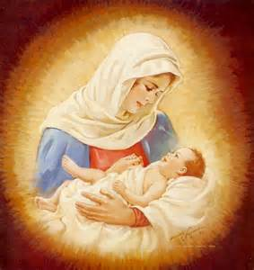
Choice Work 4
Category: Movements involving an instrumental or vocal soloist or a group of soloists or choir interacting with an accompanying ensemble
Name of work: For Unto Us a Child is Born
Composer: G. F. Handel
Features:
Composed for the oratorio (religious work for chorus & orchestra) The Messiah
Major Key & Joyful Mood (Represents Jesus’ birth in the story)
Full Soprano, Alto, Tenor, Bass (SATB) choir
Orchestral intro & accompaniment (strings, woodwind & harpsichord)
Has both homophonic & polyphonic sections

Slide 6
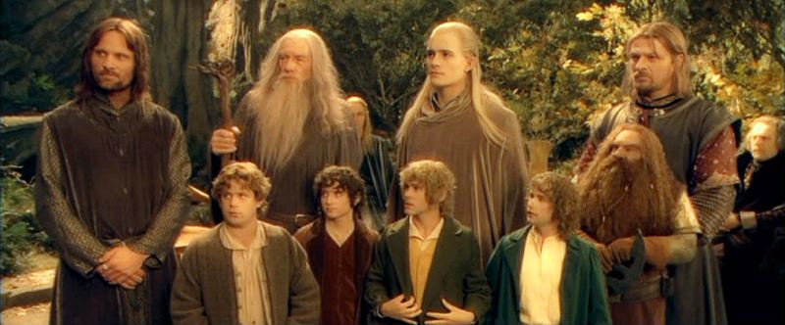
Choice Work 5
Category: Illustrative & Film Music
Name of work: Concerning Hobbits (from Lord of the Rings: The Fellowship of the Ring)
Composer: Howard Shore
Features:
Intro = pizzicato strings (nibble Hobbits)
Key = both Major (happy) & Modal (old & ancient sounding)
Folk instruments used are whistle (ornamentation), fiddle & accordion (suggests simple country life)
Opening melody has a narrow range (Hobbit’s small size)
Ternary form ABA

Slide 7
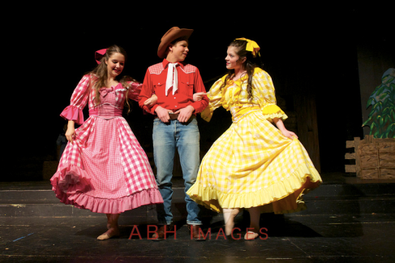
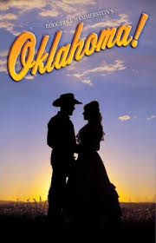
Choice Work 6
Category: Concert overtures, overtures, instrumental preludes or intermezzi from stage musicals, plays, operettas, operas or oratorios
Name of work: Overture to Oklahoma! (from the musical Oklahoma! Which is set in the Southern US state of Oklahoma – cowboys)
Composer: Richard Rogers
(collaborated for the lyrics
of the songs with Oscar Hammerstein)
Features:
The overture was written as an introduction to the musical & contains numerous songs (played by orchestra – no voices) from the musical to prepare the audience for the show.
All tunes are in a major key
Tempo = fast & lively
Begins with a long trill on violins
Music become pianissimo (ppp) at the end and then suddenly louder (crescendo) in the final few bars

