Slide 1
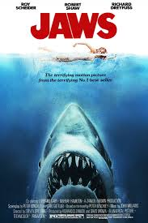
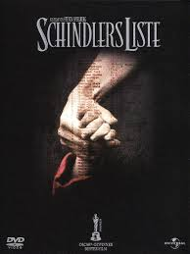
General Study
Question 10 – 20 marks
Higher Level = 2x pieces of music & 3 musical features
Ordinary Level = 2x pieces of music & 2 musical features

Slide 2
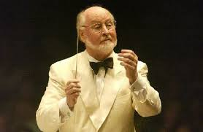
Name of general study:
The film music of John Williams
Category: Day-to-day Music: Film music
Two pieces of music and their composer/performer:
a. The theme from Schindler’s List – John Williams
b. The theme from Jaws – John Williams

Slide 3
Musical feature 1: Melody (Use of Intervals – Long & Short)
Schindler’s List
Many unusual intervals used - do not follow the rules of composition.
Begins with leap of an octave
Has many leaps of a seventh
Leaps of over an octave e.g. 9th are often used.
I don’t think they sound out of place at all – melody always comes back within this leap

Slide 4
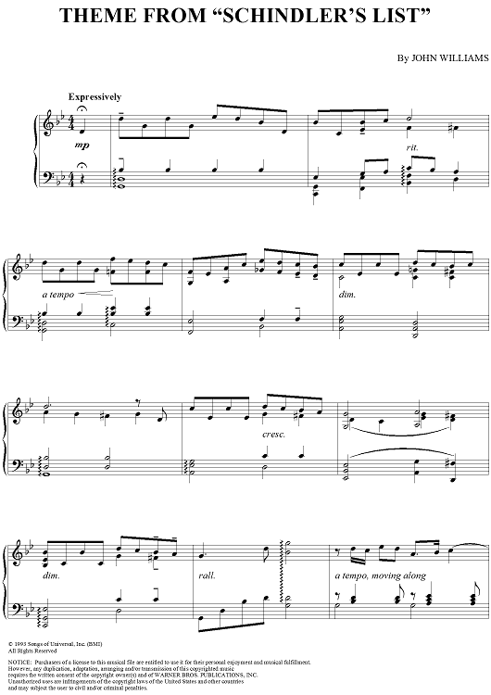

Slide 5
Musical feature 1: Melody (Use of Intervals – Long & Short)
B. Jaws
A much smaller interval used
Bass part repeats the interval of a semitone (half-step) between notes.
Incredibly small in comparison but is still very effective & memorable to the listener.

Slide 6
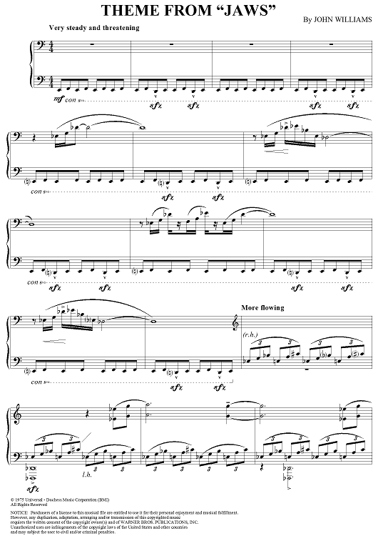

Slide 7
Musical Feature 2: Instrumentation (Help tell the story – Underscore & Sound effects)
A. Schindler’s List:
Solo violin plays the melody
Much more personal sounding than a bigger group of instruments.
Represents the individual pain experienced by each Jew
Good choice as it can play the wide range of notes in this melody with ease and can produce rich vibrato & legato notes (adding to the emotion of this sad story)

Slide 8
Musical Feature 2: Instrumentation (Help tell the story – Underscore & Sound effects)
B. Jaws
Paint picture of shark attack
Beginning = bassoons & double basses are all played at a low pitch in the bass clef (shark lurking at the bottom of the seabed)
Short phrases on french horns = boat horns above water warning of a potential shark attack.
Other brass & percussion enter with accented notes as melody slowly rises & tempo becomes livelier (shark rising towards the surface ready to attack)

Slide 9
Musical Feature 3: Mood created (using tempo, dynamics & tonality/key)
A. Schindler’s List
Mood = lamenting & despairing . The story of Jews in concentration camps whom Schindler was trying to save.
Tempo = slow expressive (time passing extremely slowly)
Dynamics = constantly changing -> piano, crescendo, forte, decrescendo (rollercoaster of emotions)
Tonality/Key = minor (gas chambers, concentration camp, death etc) but short sections that sound major (glimmer of hope Schindler gave them)

Slide 10
Musical Feature 3: Mood created (using tempo, dynamics & tonality/key)
B. Jaws:
Mood = Tense/Terrifying/Suspense. The story of a great white shark rising through the depths to attack a victim or terrorise sailors and swimmers.
Tempo: begins very slowly and with exaggerated pauses it speeds up (shark lurking in the depths & springing to life when it spots its prey)
Dynamics: very dramatic with extreme crescendos & decrescendos creating tension & suspense.
Tonality/Key = also mostly minor (unpleasant swim a great white shark)

